Slide 1
Internship Web Portal
~ by Clean Frame

Slide 2
Group Members
IIB2019017
IIT2019211
Ambika Singh Kaushik
Divy Agrawal
IIT2019210
IIT2019218
Aditya Aggarwal
Anmol Bansal

Slide 3
Table of Contents
Technology Use
Goals and Motivation
1
2
Potential Application
Work Division
3
4
Use Case
Project Completion Strategy
5
6
Traceability Matrix
Test Plan
7
8
Demonstration
Security
9
10

Slide 4
1
Technology Use
Framework
Back-end language
Django
Python
Database
Sqlite3
Front-end
HTML5
CSS
JS
JINJA.
Website Hosting
Heroku
https://clean-frame.herokuapp.com/

Slide 5
2
01
Interface Between Students and Companies
To provide a platform for college students to compete between them to get an internship in the registered company.
To provide a platform for companies to offer internships and choose the best of best students by taking their evaluations in different phases of an internship.
To provide a platform for companies to store the internship results online securely so that they can export them from any device capable of running the web app.
To provide a platform where students can see company details and vice-versa.
Goals and Motivations

Slide 6
2
02
Interface Between Staff And Non-Staff
To implement the one student one job policy such that when a student gets an internship in the present season, he can’t apply for other internships in that season.
When a database is managed, staffs can easily take care of other internship rules and criterias.
To provide a smooth platform for staff and students/companies(non-staff) where non-staff can seek tech support from staff and staff can give notifications to non-staff so that they remain updated day to day..
Goals and Motivations

Slide 7
2
03
Interface Between Admin And Staff
To provide a smooth platform for admins and staffs where admins can track staff permissions and all those staff users(even admin) need specific permissions for every staff activity they are capable of.
Here, staff with permissions can ban/ unban users, create new staff/company accounts and many more..
Goals and Motivations

Slide 8
3
Potential Application
This application is specifically designed with an approach of internship for IIITA.
This could also be extended for placement portal instead of internship portal or could be duo of both.
The project can be extended for internship portal of different college.
This application could serve as a base for other applications like Aviral by slight modifications in code.

Slide 9

4
Work Division
User Analysis
The User analysis was done by our group members to know what are the requirements/features the user expect from us. So that we could deliver a high end product.
GUI
The application must be very interactive, responsive as only then user would be attracted to use the application. Without this the application would serve no purpose.
Processing Speed
The application must be fast only then it would serve the for which user is using the application else he has to wait too long which will become very annoying.
Division
The above three tasks were completed by the involvement of all the members by gathering on a meet and helping each other out.

Slide 10
5
Use Cases

Slide 11
5
Details of these all 24 categories have been discussed in the Software Requirement Specifications Document.
Basically we have 43 Use cases
For the Implementation and Understanding simplicity we categorized these 43 uses cases into 24 use cases.
Some of these have been listed on next slide

Slide 12
5
Some Main Highlights
Login
Sign Up
User Verification
Forget Password
Manage Accounts
Restrict User
Notification
Internship Announcement
Registration in Internship
Technical Support
Roll back Application
Blog Management

Slide 13
6
Project Completion Strategy
Documentation Phase
Phases
In this phase we completed the documentation of the SRS and the SDS.
Documentation Phase
Coding Phase
Testing Phase
Deployment Phase
Coding Phase
In this phase we developed our application based on the documentation and the designing strategies.
Testing Phase
In this we will be testing our application for potential bugs and will be trying to fix them.
Deployment Phase
In this the application will be made available for use by the potential users by hosting the application.

Slide 14
7
Traceability Matrix

Slide 15
8
Test Plan

Slide 16
9
Demonstration

Slide 17

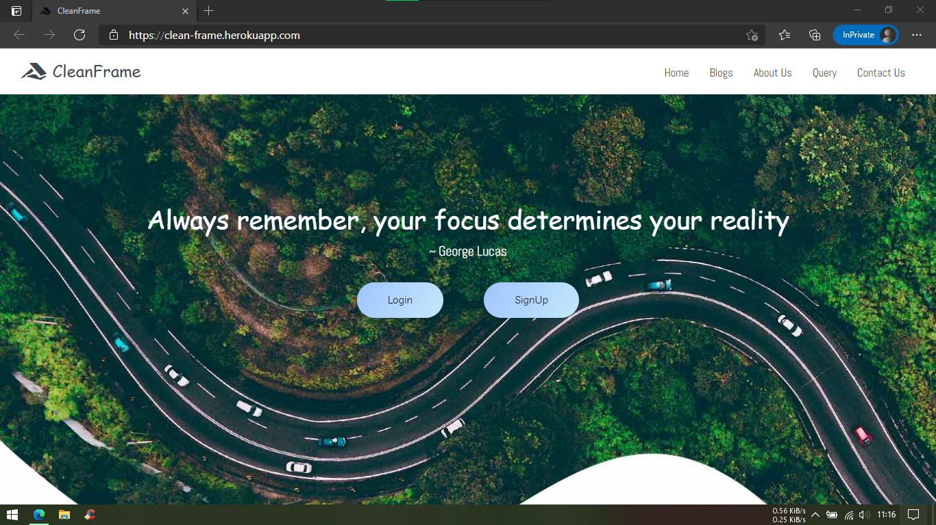
9
Responsiveness

Slide 18
10
Security

Slide 19
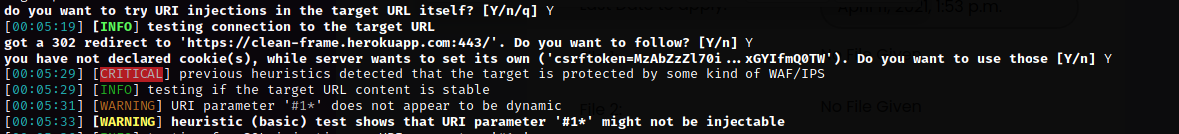
10
Protection from SQL INJECTION

Slide 20
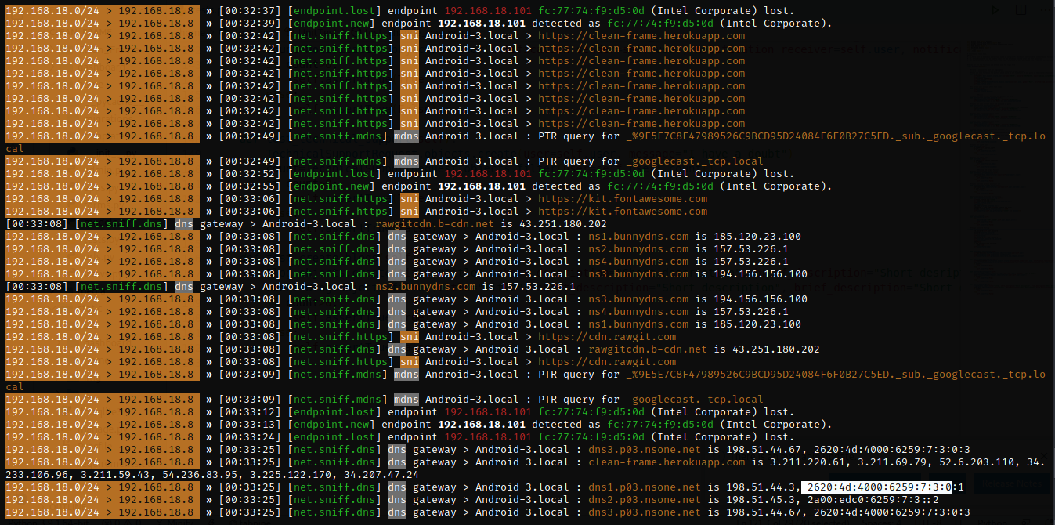
10
Protection from MITM ATTACK IN HTTPS URL

Slide 21
THANK YOU

